Slide 1
GROUP 5 MEMBERS
Affan Tariq 172055
Amna Atiq 172058
Aashir Imran 172067
Firzam Khan 172113
Zain Shahid 172093

Slide 2
News Feed

Slide 3
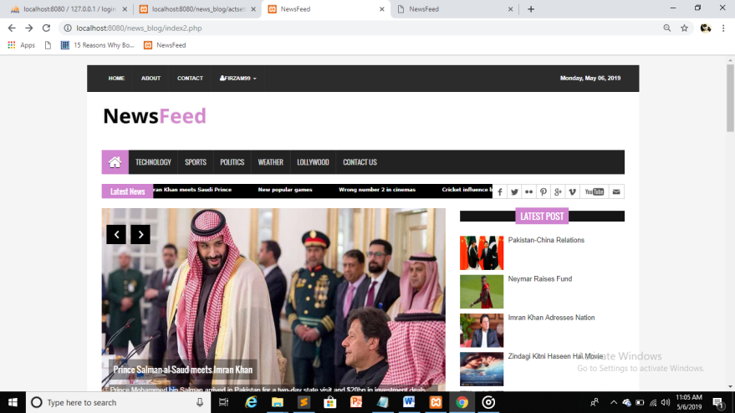
News Feed Site

Slide 4
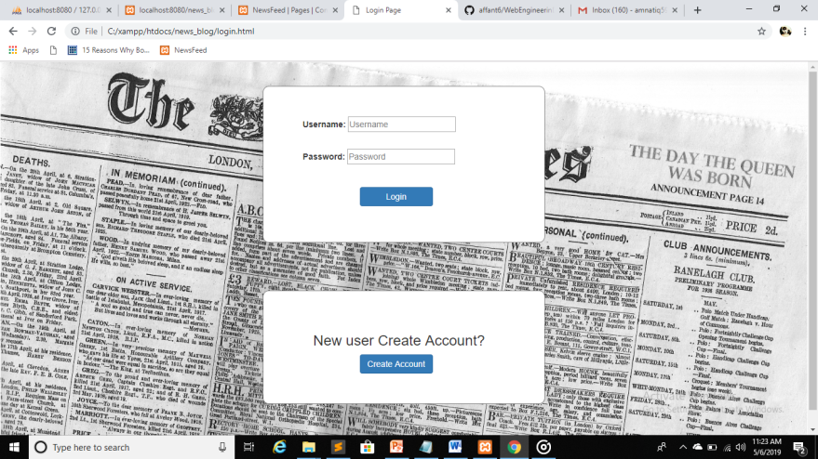
Log in

Slide 5
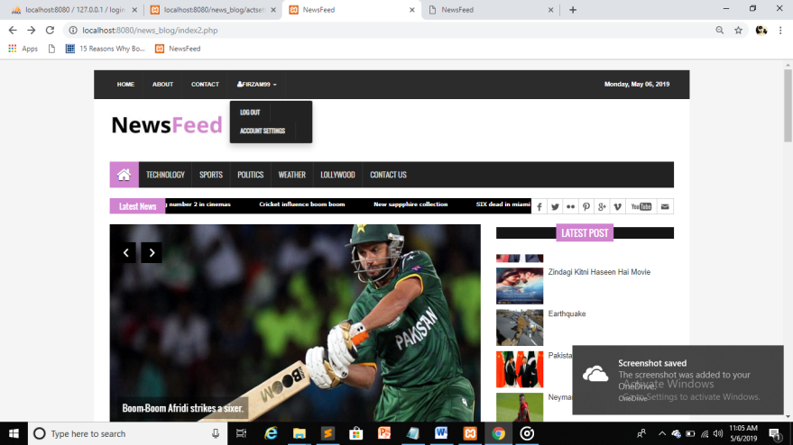
Account

Slide 6
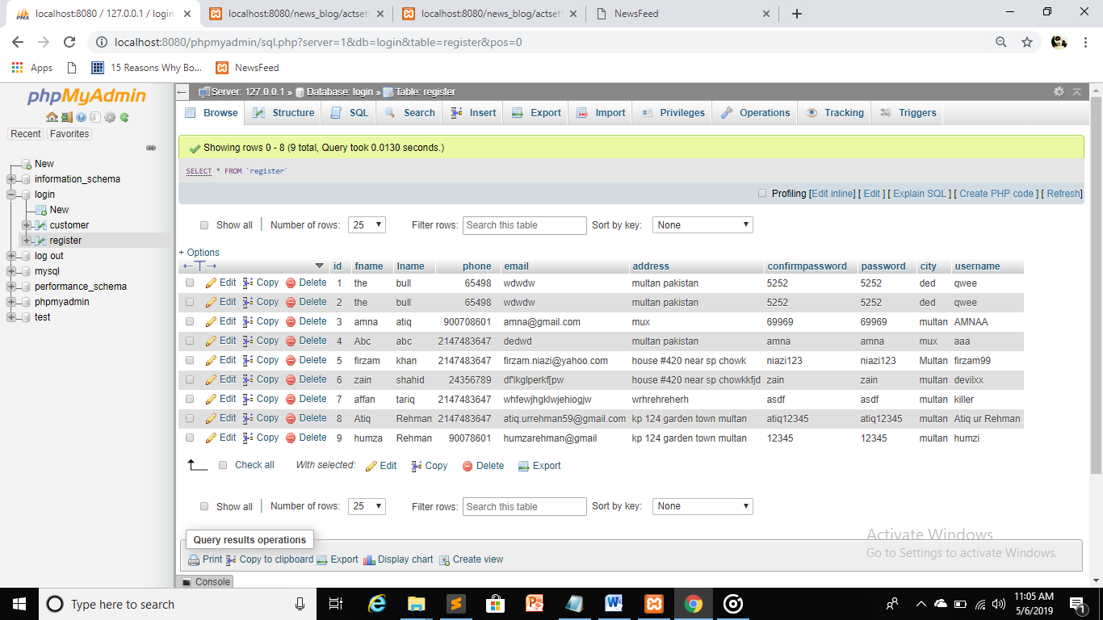
Database

Slide 7
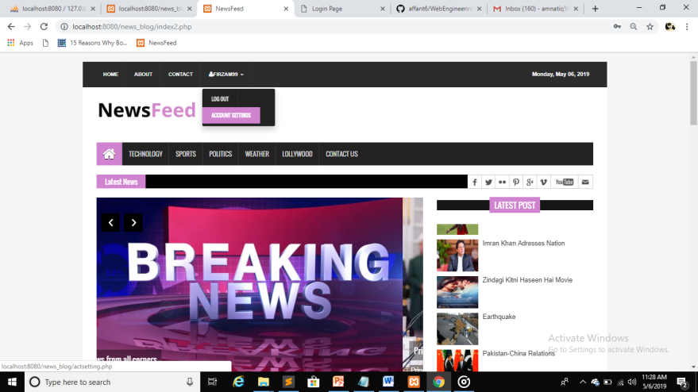
Account settings

Slide 8
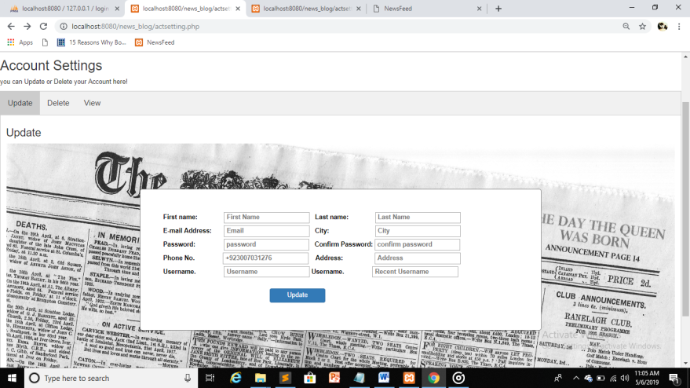
Account settings

Slide 9
Data base Update

Slide 10
Lets Have a View of our Site

Slide 11
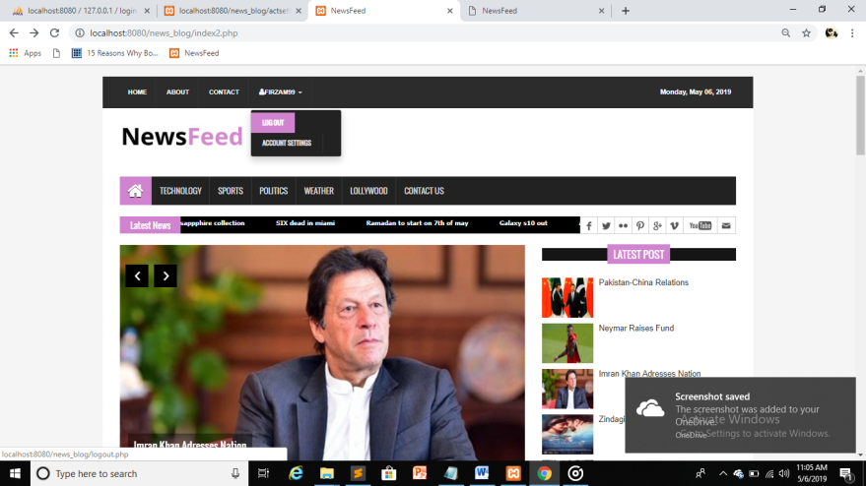
Home Page

Slide 12
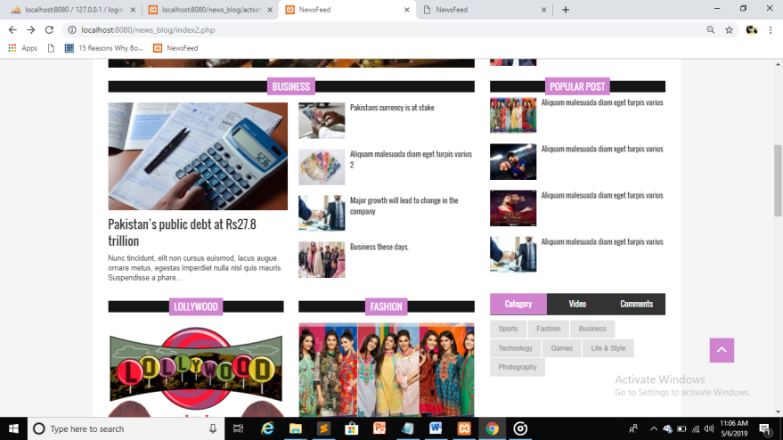

Slide 13
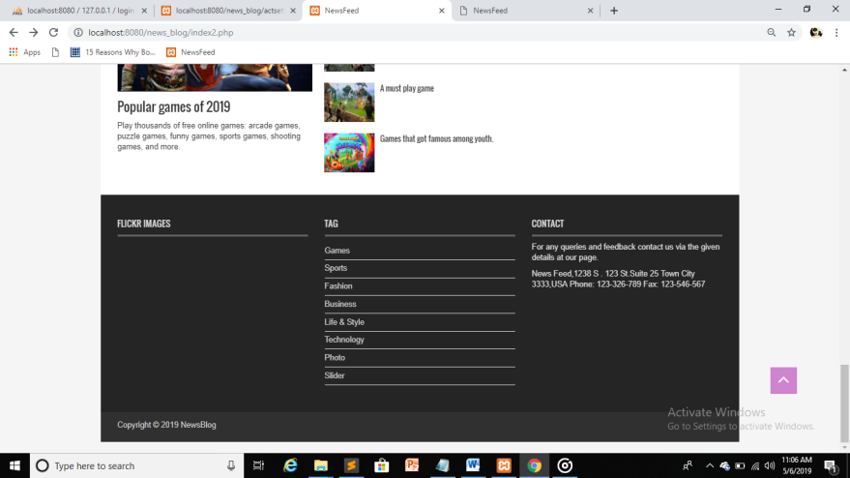
Footer

Slide 14
Thankyou

